Slide 1
Design Patterns and Principles
Lecture 03

Slide 2


Test Automation Design
Why should we care about?

Slide 3


Solid Principles
Help to make software design more understandable, flexible, and maintainable
Liskov Substitution Principle
Derived classes must be substitutable for its base classes.
Single Responsibility Principle
Interface Segregation Principles
A class should have one, and only one reason to change.
Make fine grained interfaces that are client-specific.
Open Closed Principle
Dependency Inversion Principle
You should be able to extend a class behavior without modifying it.
Depend on abstractions, not on concretions.

Slide 4
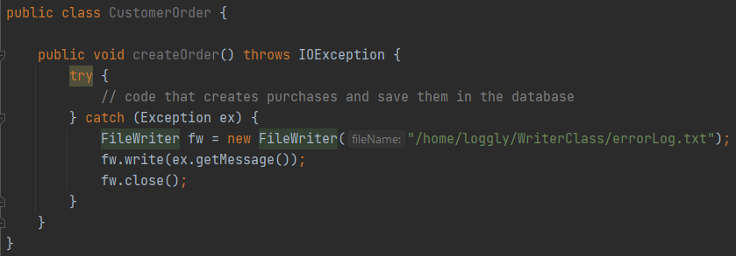
SRP - Single Responsibility Principle
“Every class should have responsibility over a single part of that program's functionality, which it should encapsulate.”
Example:

Slide 5
OCP - Open/Closed Principle
“Software entities (classes, modules, functions, etc.) should be open for extension, but closed for modification.”
Initially proposed approach with inheritance
“A class is closed, since it may be compiled, stored in a library, baselined, and used by client classes. But it is also open, since any new class may use it as parent, adding new features. When a descendant class is defined, there is no need to change the original or to disturb its clients.” - Bertrand Mayer 1988
Later on redefined to Polymorphic Open/Closed Principle

Slide 6
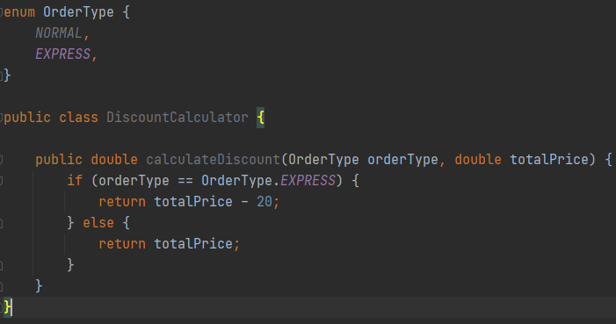
OCP - Open/Closed Principle - Example

Slide 7
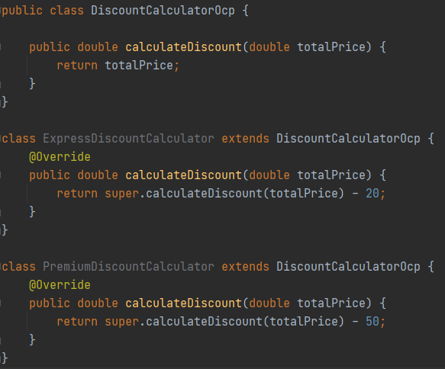
OCP - Open/Closed Principle - Example

Slide 8
LSP – Liskov Substitution Principle
Should be able to use any derived class instead of a parent class and have it behaved in the same manner without modification.
It means that the child class shouldn't modify or change how the base class behaves.
The child classes can be used as if they are their parent itself, but if you change behavior in a child class, unexpected issues will occur.

Slide 9
LSP – Liskov Substitution Principle - Example
Discount Calculator example
In the context of Test Automation

Slide 10
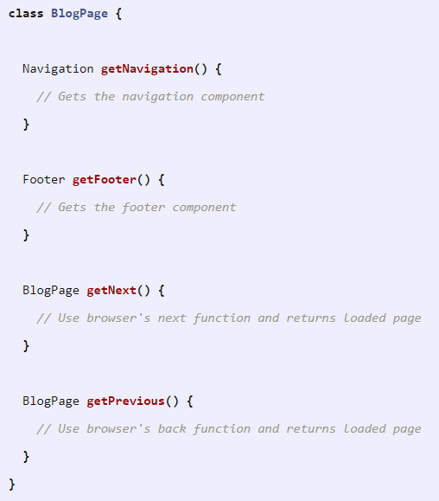
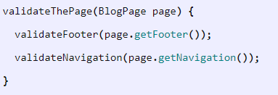
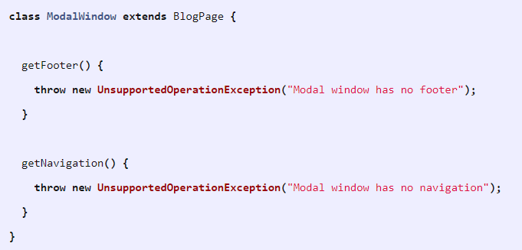
LSP – Liskov Substitution Principle - Example
2
3
1

Slide 11
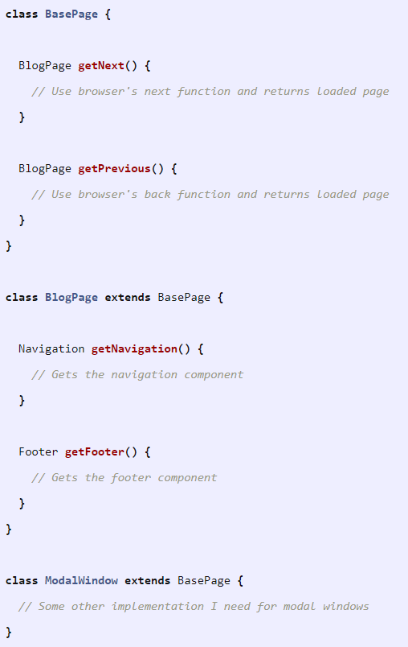
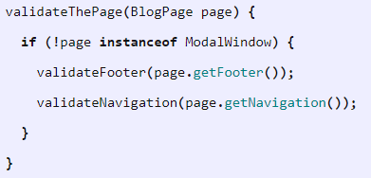
LSP – Liskov Substitution Principle - Example
5
4
Potential fix but violates Liskov principle.

Slide 12
ISP – Interface Segregation Principle
Clients should not be forced to implement interfaces they don't use.
Instead of one fat interface, many small interfaces are preferred based on groups of methods, each one serving one sub-module
Each interface should provide methods that serve a single purpose.
Identifying the distinct interfaces can sometimes be a challenge as careful considerations are required to avoid proliferation of interfaces.
While writing an interface, consider the possibility of implementation classes having different sets of behaviors, and if so, segregate the interface into multiple interfaces, each having a specific role.

Slide 13
DIP – Dependency Inversion Principle
“High-level classes should not depend on low-level classes. Both types should be created based on abstractions. These abstractions shouldn't depend on any low-level details. All details should use the abstractions instead.”
If you combine OCP and Liskov principles then you are satisfying this principle too.

Slide 14




design patterns used in Test Automation
What is a Design Pattern?
Prescribed solutions to everyday software challenges. They don't consist of code or any specified algorithm, but instead, they describe how to group your logic smartly, reuse it, or to make it easier to maintain. It is a template for solving design problems, which we can use while we create our software solutions.
Page Object pattern
Factory pattern
Facade pattern
Singleton pattern

Slide 15
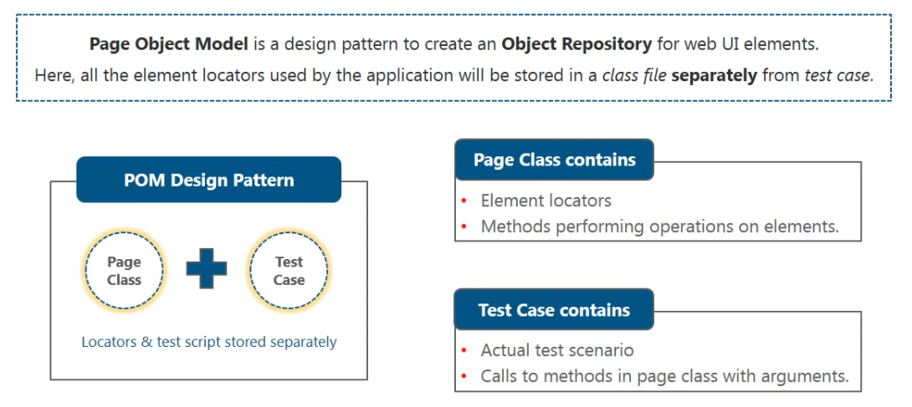
Page Object Pattern

Slide 16
Factory Pattern
“In the factory design pattern we have a super class with multiple subclasses and based on some input, we need to return a particular subclass.”
Often used when a class cannot anticipate the type of objects it needs to create beforehand
Instantiation of a class is done from the factory class. So when we need to create the object based on particular input this pattern is used.

Slide 17
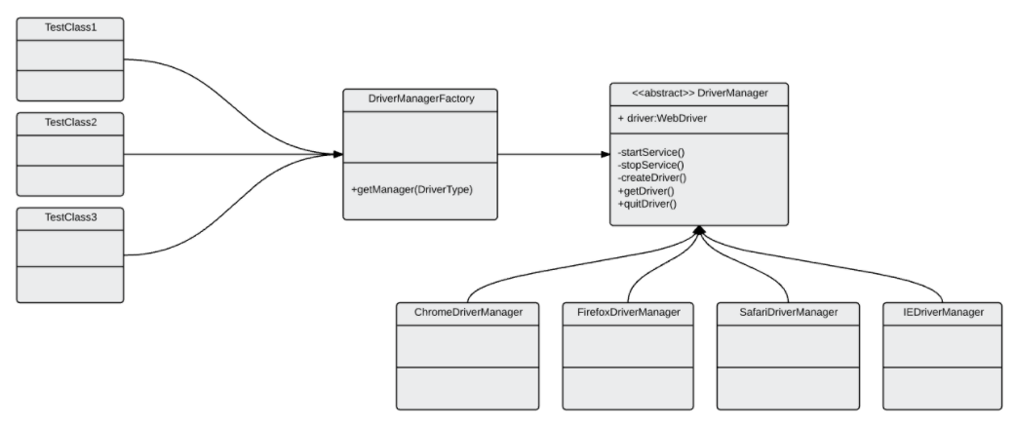
Factory Pattern - Example

Slide 18
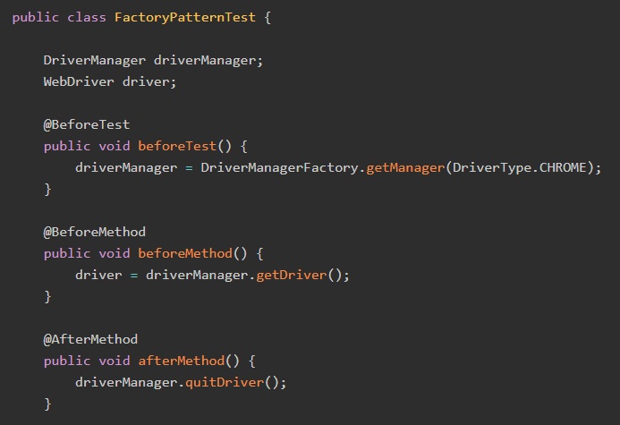
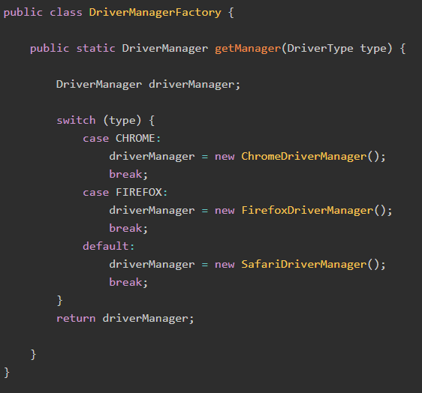
Factory Pattern - Example

Slide 19
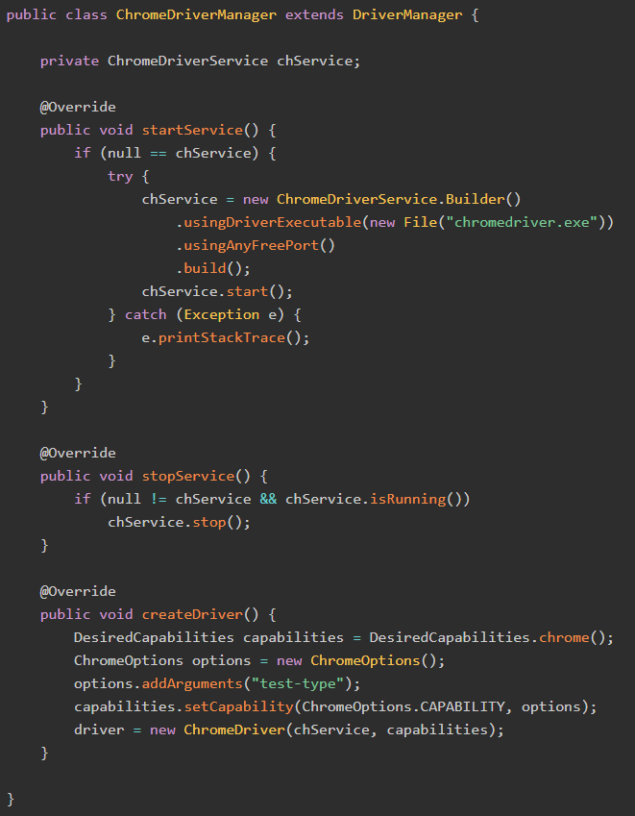
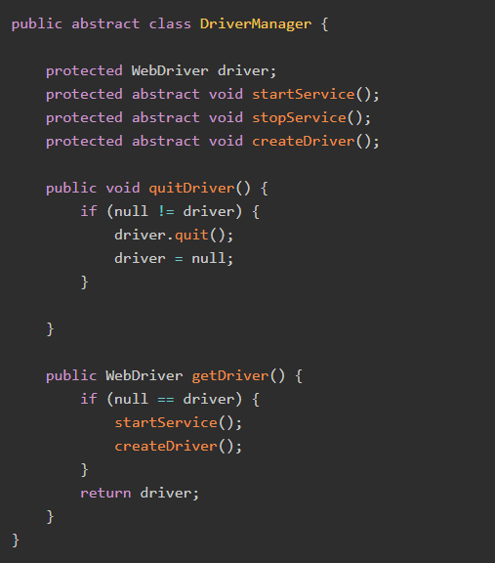
Factory Pattern - Example

Slide 20
Facade Pattern
The Facade pattern provides a simple interface to deal with complex code.
Applied to test automation, we design the facade class which has methods that combine actions executed on different pages.

Slide 21
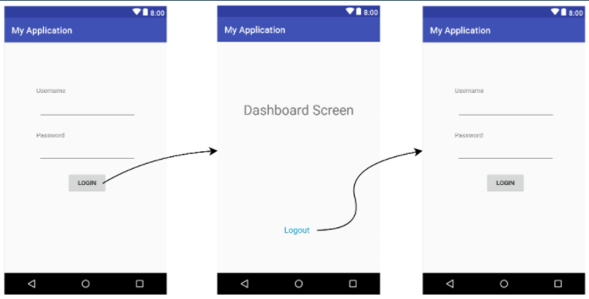
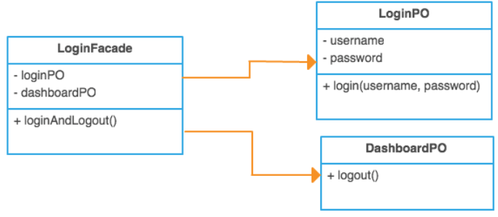
Facade Pattern
In case any workflow changes in your test cases you just need to change it in one place, and if you want to add some additional business logic, you can directly add them to the facade class

Slide 22
Singleton Pattern
“A Singleton class means only one instance of it can exist at any time.”
Very useful in a case when you need to use the same object across the whole framework. A Singleton class returns the same instance every time you try to instantiate an instance of the class.
Usage in Test Automation
Keep track of same driver instance throughout execution.
DBMS connectivity.
Loading external files like properties, excel etc once rather than loading again and again.
Logger.

Slide 23
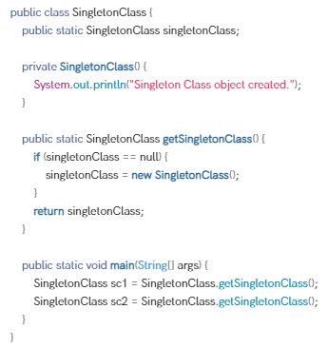
Singleton Pattern
How to create a Singleton class?
Making the constructor of the Class private.
Make a static reference of the class, as we want to make this available globally.
Make a static method which returns an object of type class and it should also check whether class is already instantiated once or not - if it’s not instantiated then it should instantiate that otherwise it can return reference of the class directly.

Slide 24
Other Design Patterns
Builder pattern – https://en.wikipedia.org/wiki/Builder_pattern
Strategy pattern - https://en.wikipedia.org/wiki/Strategy_pattern
Lazy initialization pattern – https://en.wikipedia.org/wiki/Lazy_initialization
Adapter pattern – https://en.wikipedia.org/wiki/Adapter_pattern
Composite pattern – https://en.wikipedia.org/wiki/Composite_pattern
Decorator pattern – https://en.wikipedia.org/wiki/Decorator_pattern
Iterator pattern – https://en.wikipedia.org/wiki/Iterator_pattern
Servant pattern – https://en.wikipedia.org/wiki/Servant_(design_pattern)
Template method pattern – https://en.wikipedia.org/wiki/Template_method_pattern

Slide 25
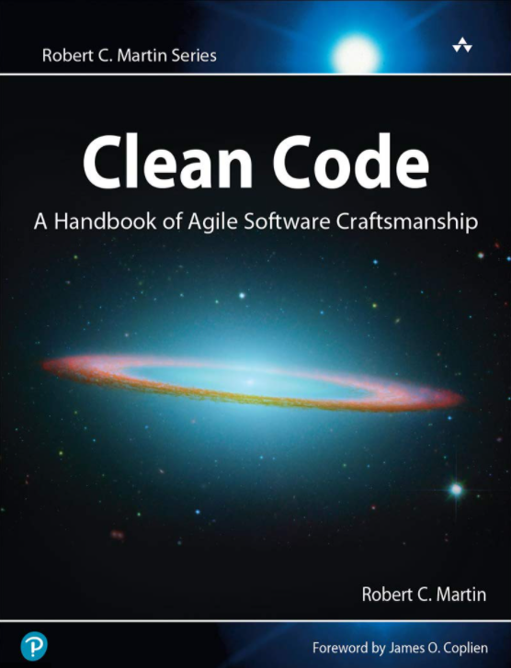
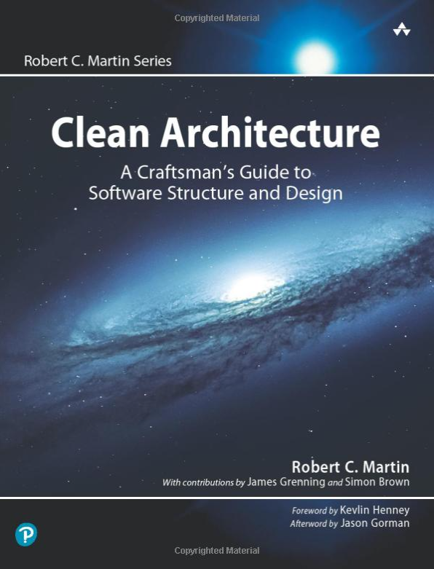
Books to read on the topic

Slide 26


